Slide 1
AI Workshop
Teesside University - Aaron Walker
5/12/2018

Slide 2
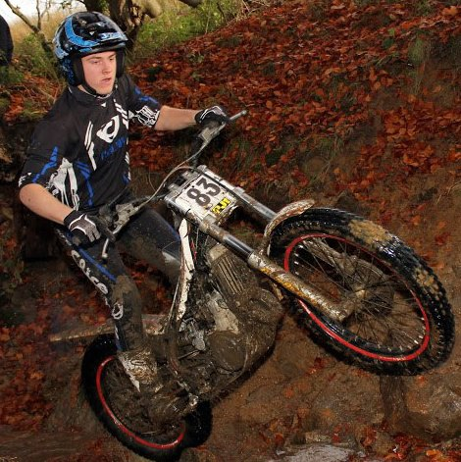
About us
Sixth form: QE, Darlington:
Double Award IT
Graphic Design
Teesside University: 3rd year computer science
Placement year: Accenture
Robotics developer
AI project
Aaron Walker

Slide 3
About Us
Highers: Newbattle Highschool:
Graphic Communication
Geography
Chemistry
Teesside University: 3rd year computer science
Placement year: DuPont Teijin Films
Software developer
Ryan O’Donnell

Slide 4
Plan
Workshop materials
Agent based modelling
What is NetLogo?
NetLogo models
Foxes and rabbits
Bridge builders
Conway’s game of life
Year 3 Artificial Intelligence assessment work
Programming!
Quiz (Prizes)
Questions
Group programming

Slide 5
Material
aaronwalker96.github.io/tuai

Slide 6
Agent based modelling
Uses “agents” to act out rules
Can have one or many agents
Agents are able to communicate and interact with other agents
Simple rules can lead to ”emergence”
Not very accurate but we may learn something interesting

Slide 7
Netlogo
World
Buttons
Sliders
Monitors
Options
Switch
Code window
Tick speed
NetLogo Download

Slide 8
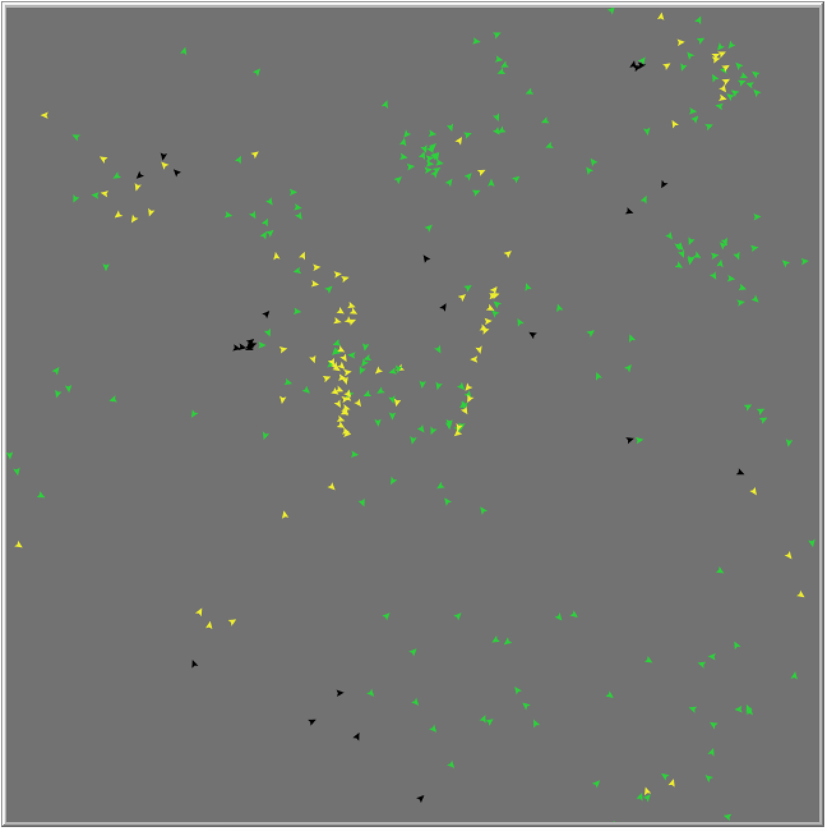
Foxes and rabbits model
Agents:
Black arrows are foxes
Green arrows are stationary rabbits
Yellow arrows are moving rabbits
Adaptive model
Foxes and rabbits are randomly generated
Constant population

Slide 9
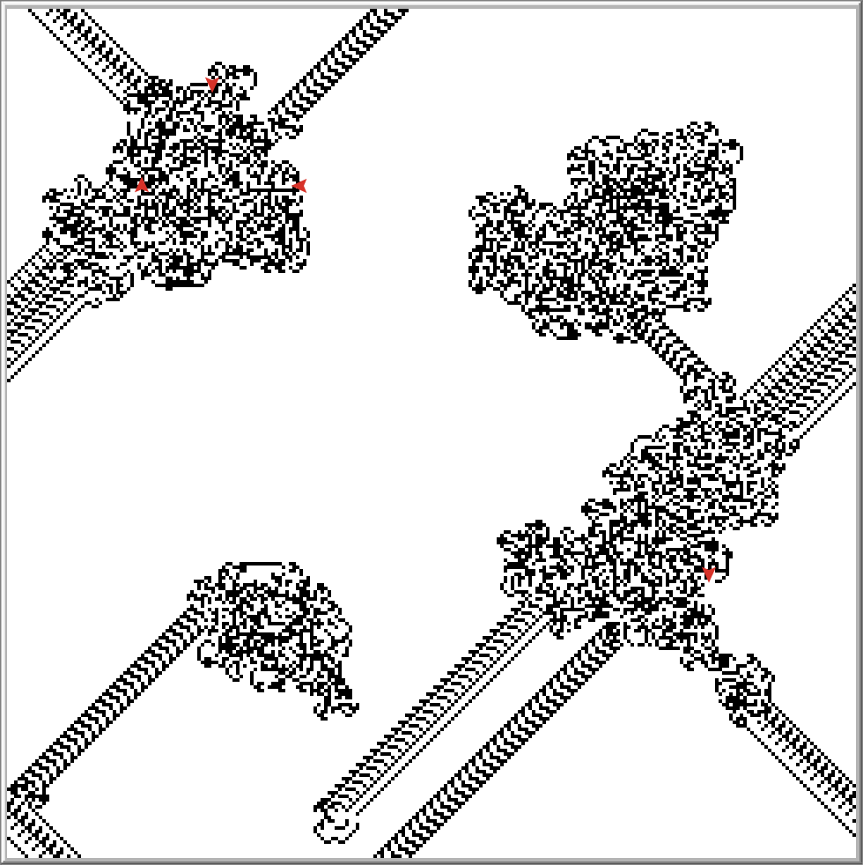
Bridge builder model
World
Black and white tiles
Agents:
flip the tile over
move forward onto the next tile
if the tile the ant is on now is white...
turn right
otherwise, if it's black, turn left

Slide 10
Conway's game of life
Agents:
Black and white tiles
Black tiles are dead
White tiles are alive
Any live cell with fewer than two live neighbours dies.
Any live cell with two or three live neighbours lives.
Any live cell with more than three live neighbours dies.
Any dead cell with exactly three live neighbours becomes a live cell.

Slide 11
Conway’s game of life
In case of emergency

Slide 12
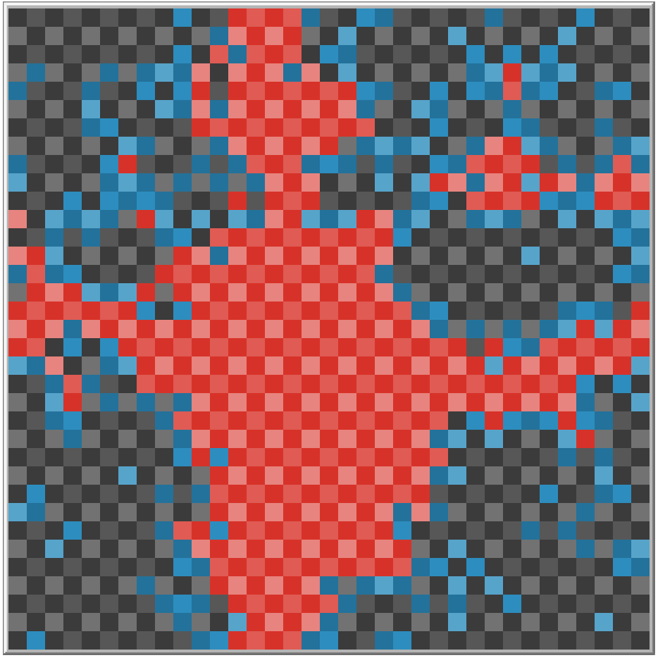
3rd year project
Model malaria and anti-malarial treatments
Uses a binary genome
Research paper
Included in the .zip

Slide 13
State machines
States
Actions
State transitions
Try it yourself:
Draw a simple state machine to plan out your day

Slide 14
State machines

Slide 15
Exercise 1
aaronwalker96.github.io/tuai
Download “Intro Examples” from the materials website
Go through the examples in the order they appear in the choice box: "patch-1", "ant-1", "rnd-ant", "rnd-ant-trail", "conway”
Experiment with changing the code and seeing what happens

Slide 16
Exercise 2
aaronwalker96.github.io/tuai
Download “Drawing robot” from the materials website
Write the code to make the robot move left, right and down
Hint: The code to move up is done for you
See what kind of shapes you can draw

Slide 17
Exercise 3
aaronwalker96.github.io/tuai
Download “Cowboys and bears” from the materials website
Complete the “cowboys.move” function, look at the “bears.move” function for tips
Experiment with changing the code and seeing what happens
Make the bears and cowboys faster/slower, see how this effects the survival rate

Slide 18
Machine learning

Slide 19
Questions
aaronwalker96.github.io/tuai

